Slide 2
1 – startVue.html
<!DOCTYPE html>
<html>
<head>
<title>My first Vue app</title>
<!-- 상용버전, 속도와 용량이 최적화됨. -->
<script src="https://cdn.jsdelivr.net/npm/vue"></script>
</head>
<body>
<div id="app">
안녕하세요 </br>
{{ message }}
</div>
<script>
var app = new Vue({
el: '#app',
data: {
message: 'Hello Vue!'
}
})
</script> <script src="1 - startVue.js"></script>
</body>
</html>

Slide 3
1 – startVue.js
var app = new Vue({
el: '#app2',
data: {
message: '안녕하세요 Vue!',
discription: ‘설명란입니다.'
}
})

Slide 4
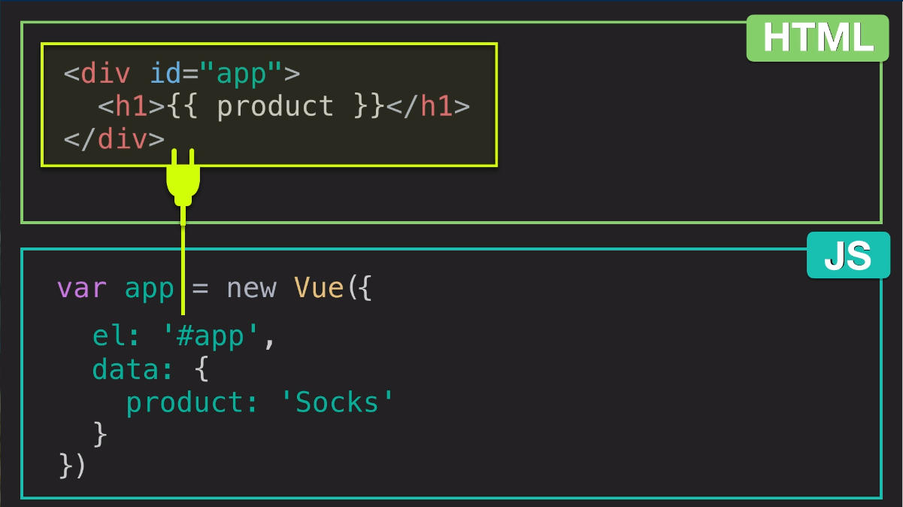

Slide 5
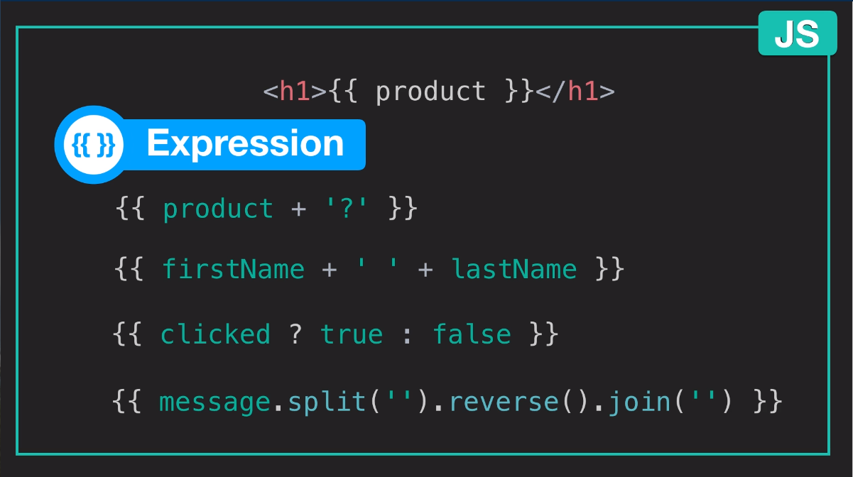

Slide 6
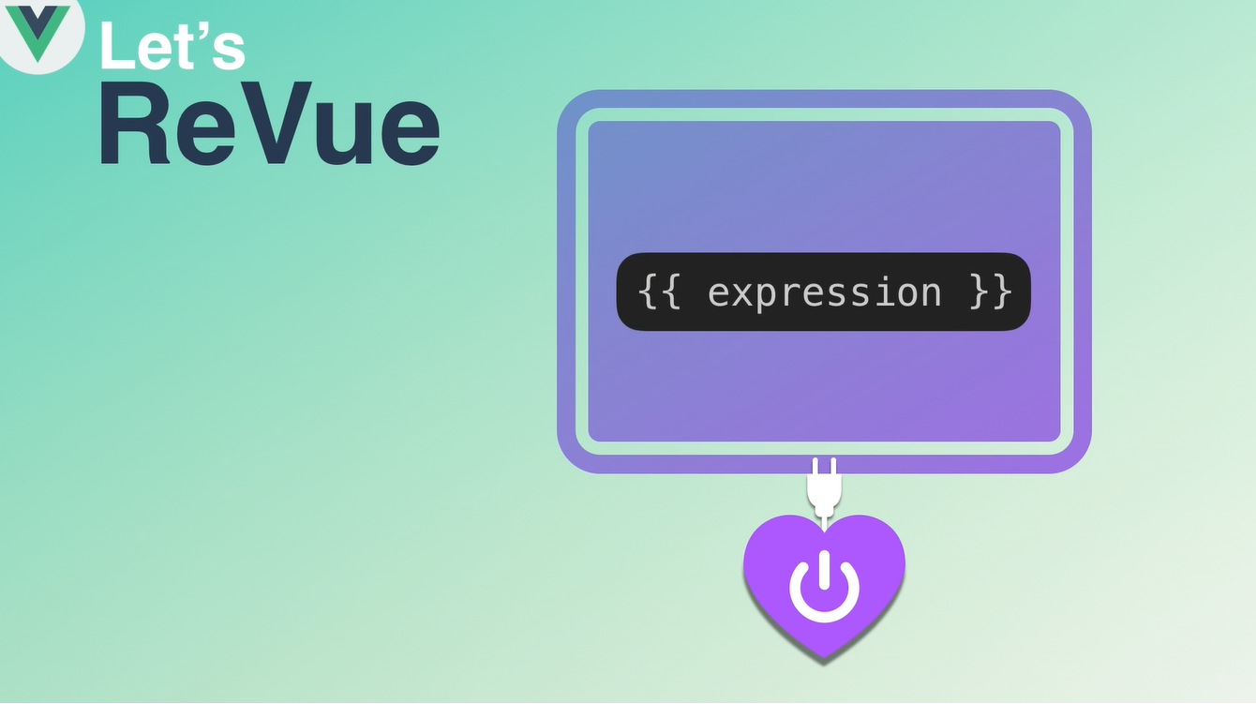
Vue instance 는 dom내의 plug-in {{ expression }} 을 사용할 수 있게 하고 instance data로 변경해 줌

Slide 7
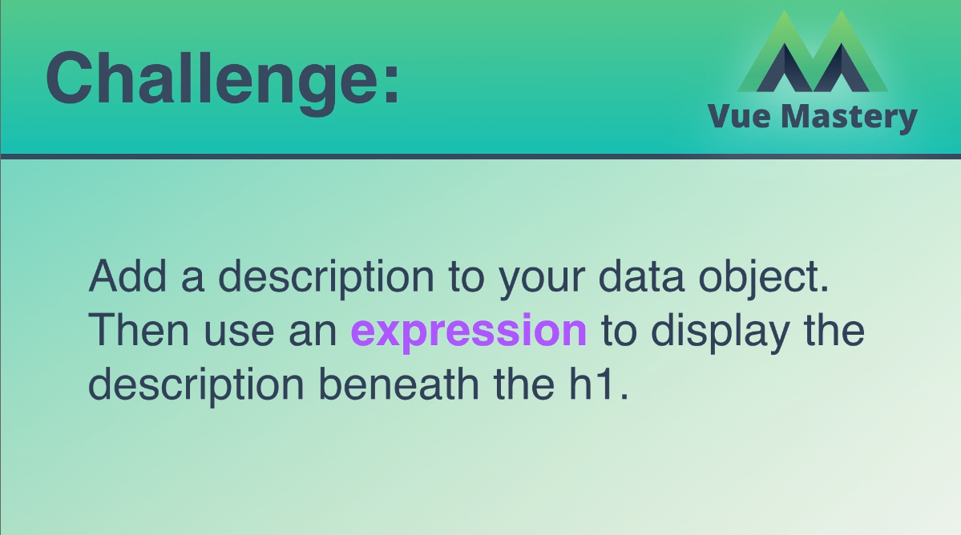

Slide 8
Assset Downloads
http://bitly.kr/oPtDny1D5A

Slide 9
Index.html
<!DOCTYPE html>
<html>
<head>
<title>Product App</title>
<link rel="stylesheet" type="text/css" href="style.css">
</head>
<body>
<div class="nav-bar"></div>
<div id="app">
<div class="product">
<div class="product-image">
<img v-bind:src="image" />
<!-- <img :src="image2" :alt="altText"/> -->
</div>
<div class="product-info">
<h1>{{ product }}</h1>
<h2>{{ discription }}</h2>
</div>
</div>
</div>
<script src="https://cdn.jsdelivr.net/npm/vue@2.5.13/dist/vue.js"></script>
<script src="index2.js"></script>
</body>
</html>

Slide 10
Index.js
var app = new Vue({
el: '#app',
data: {
product: 'Socks',
discription: 'Socks is footwear',
image: "./assets/vmSocks-green-onWhite.jpg",
altText: "A pair of socks"
}
})

Slide 11
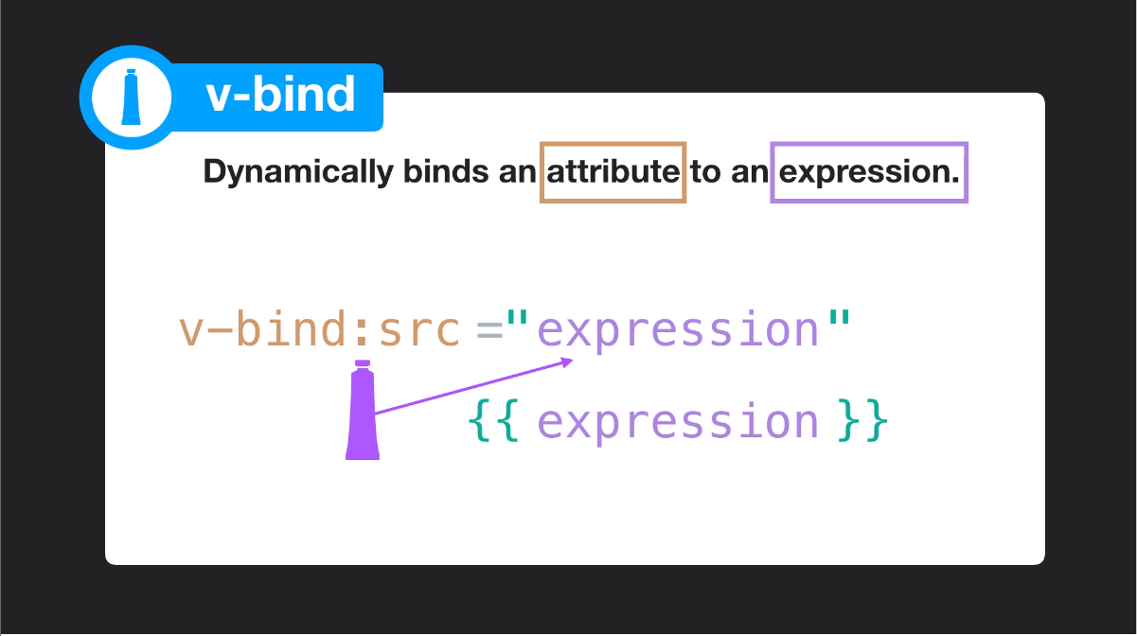

Slide 12
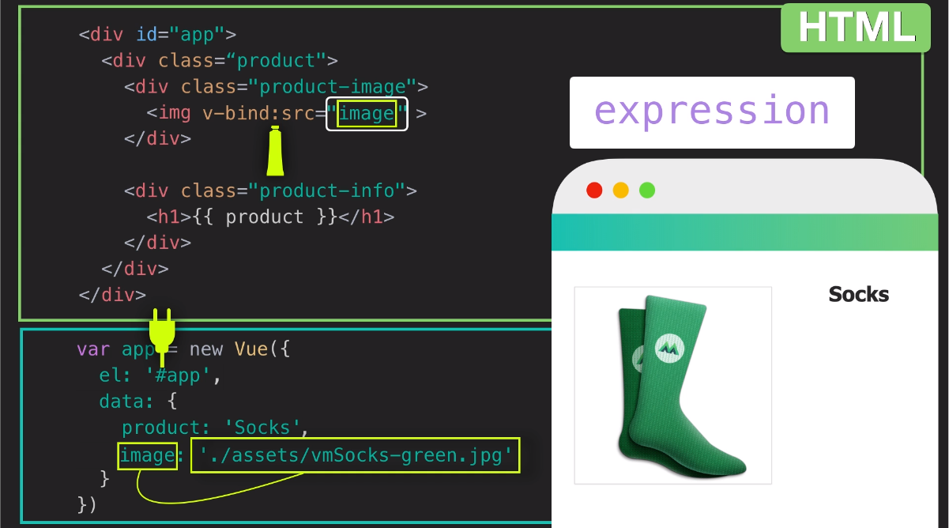

Slide 13


Slide 14


Slide 15
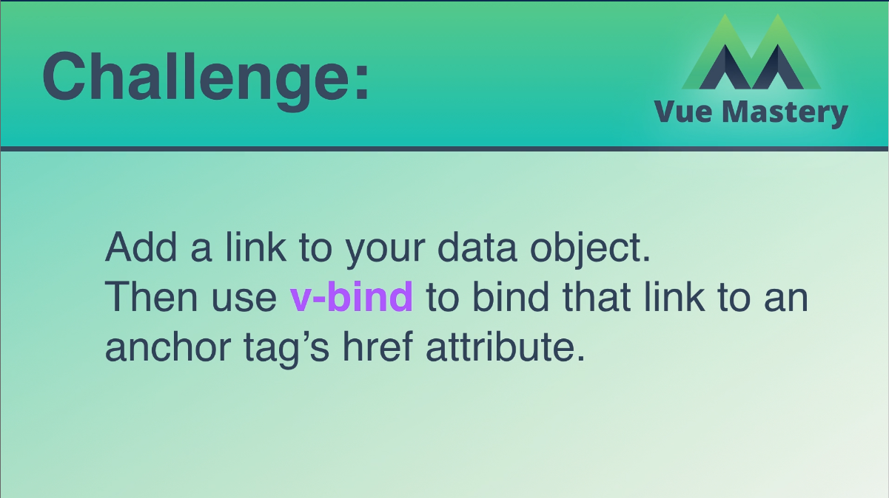

Slide 16
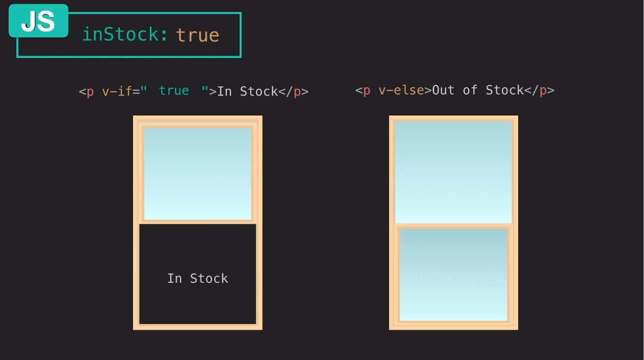

Slide 17
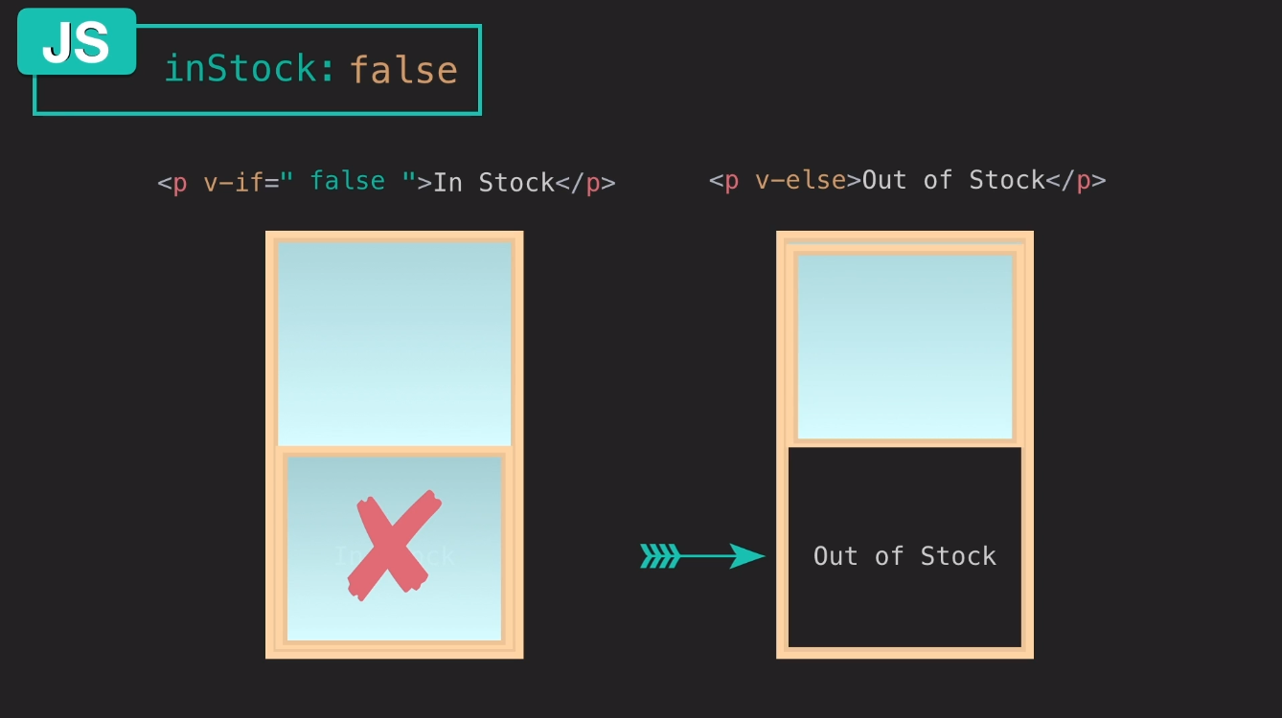

Slide 18
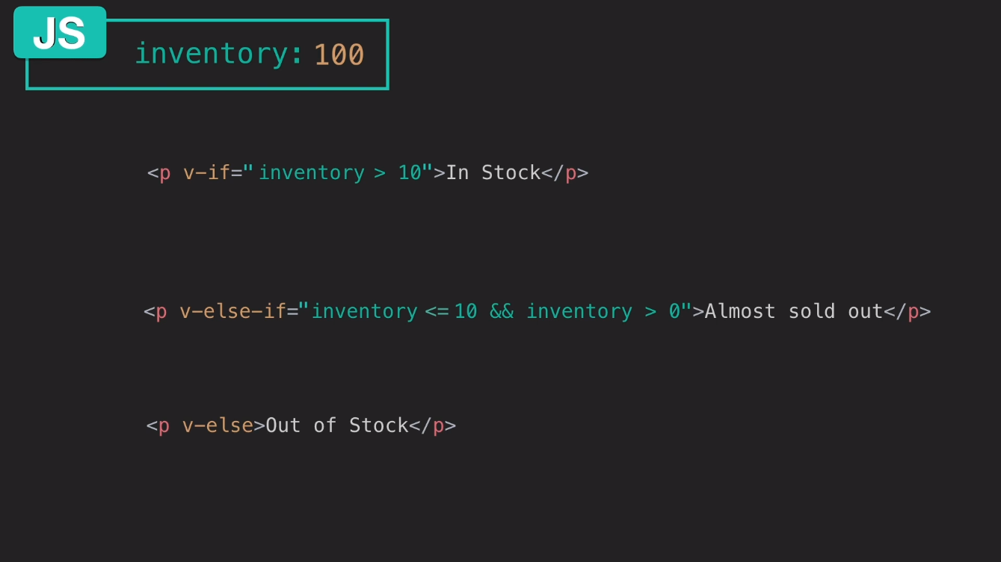

Slide 19
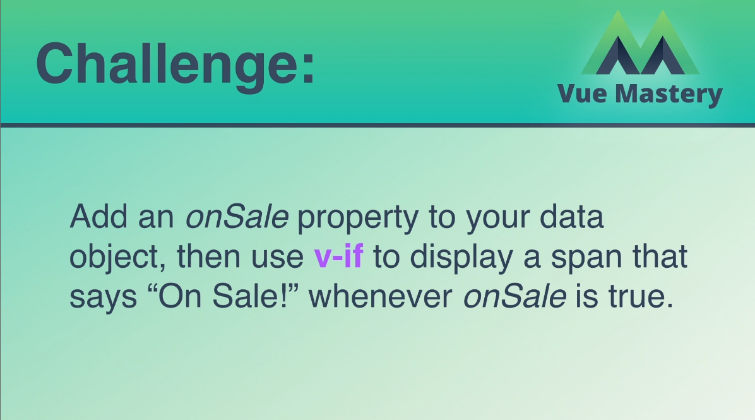

Slide 20
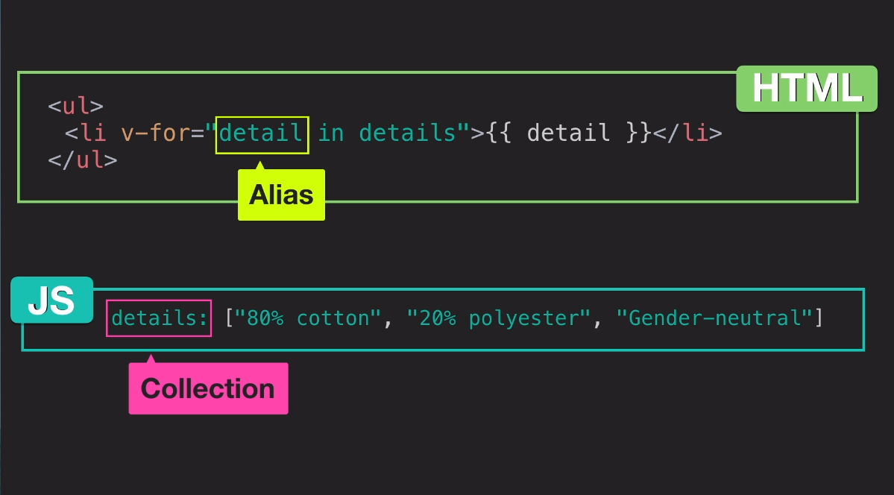

Slide 21
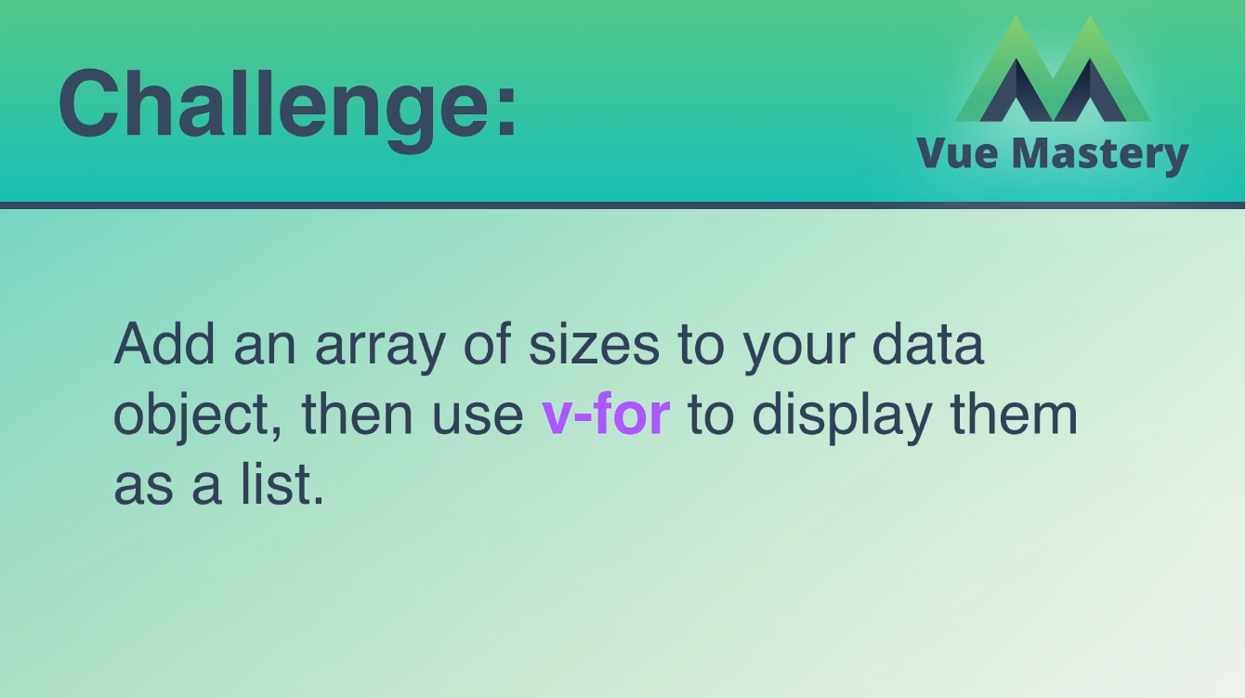

Slide 22
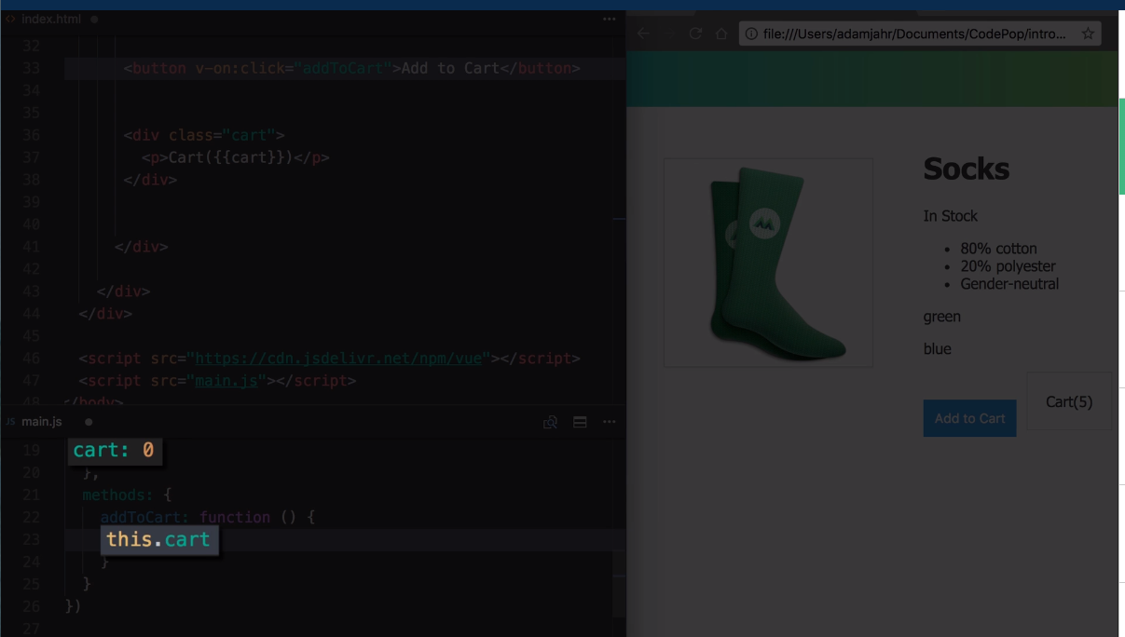

Slide 23
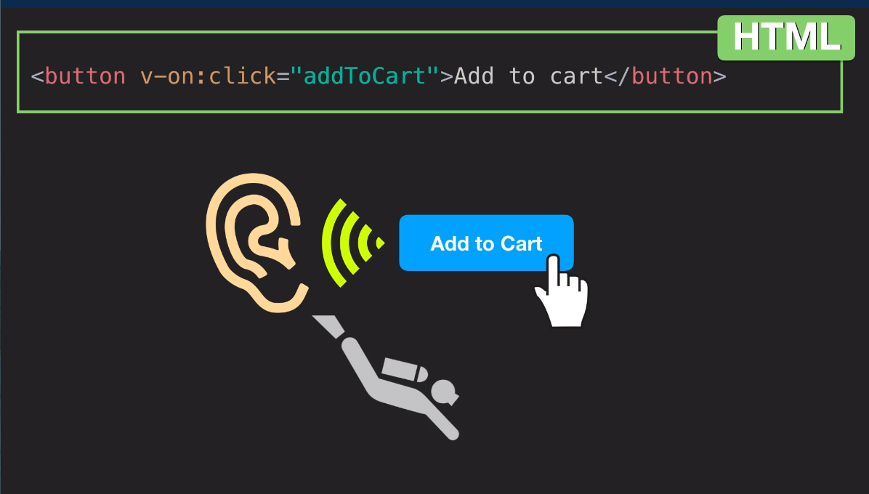

Slide 24
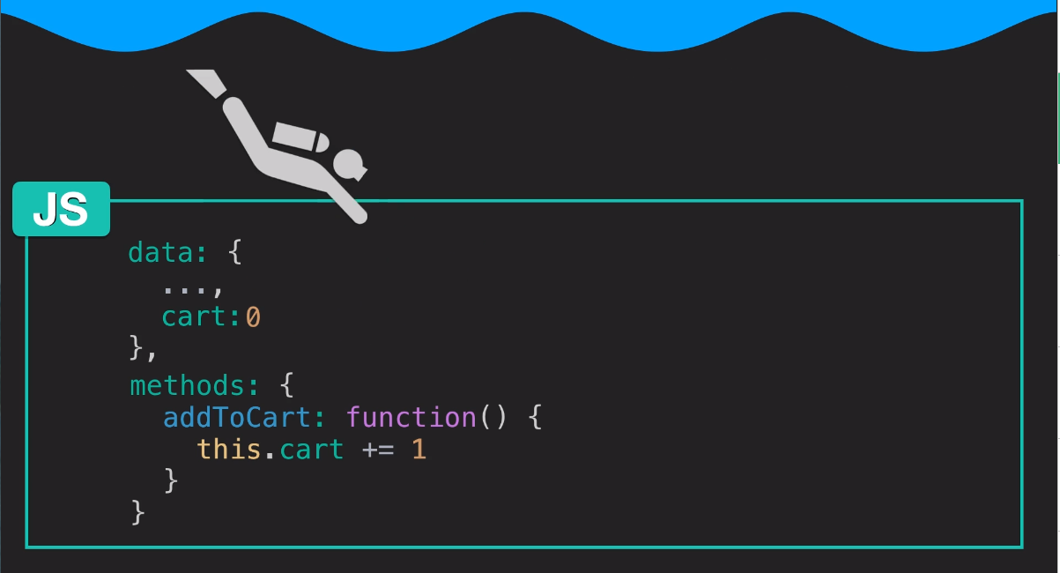

Slide 25
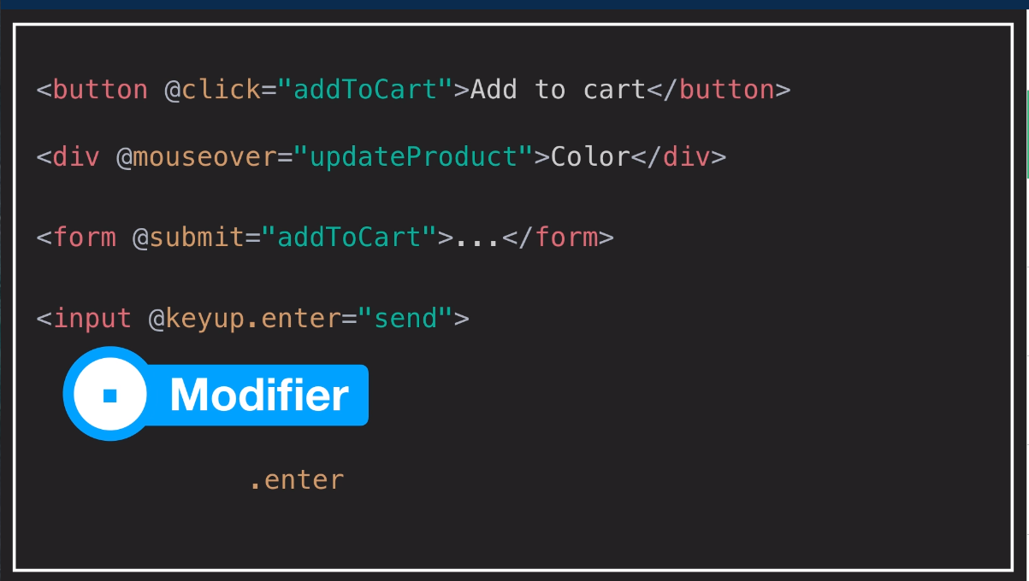

Slide 26
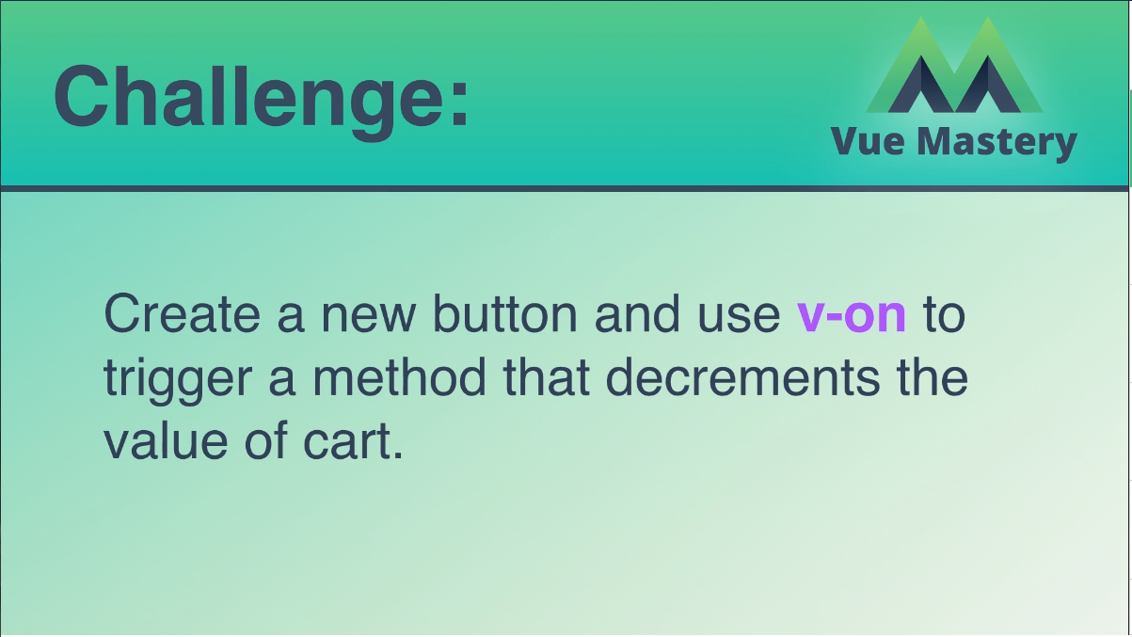

Slide 27
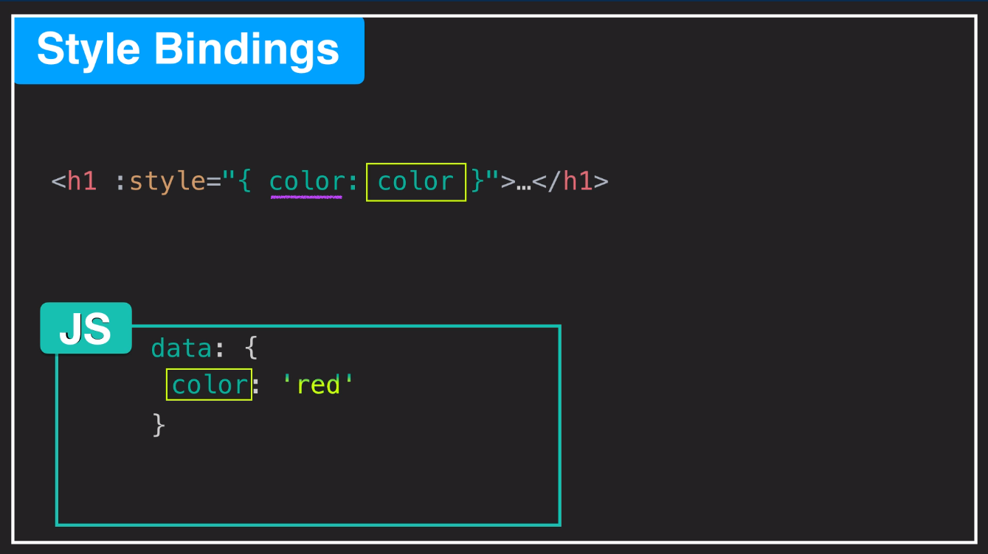

Slide 28
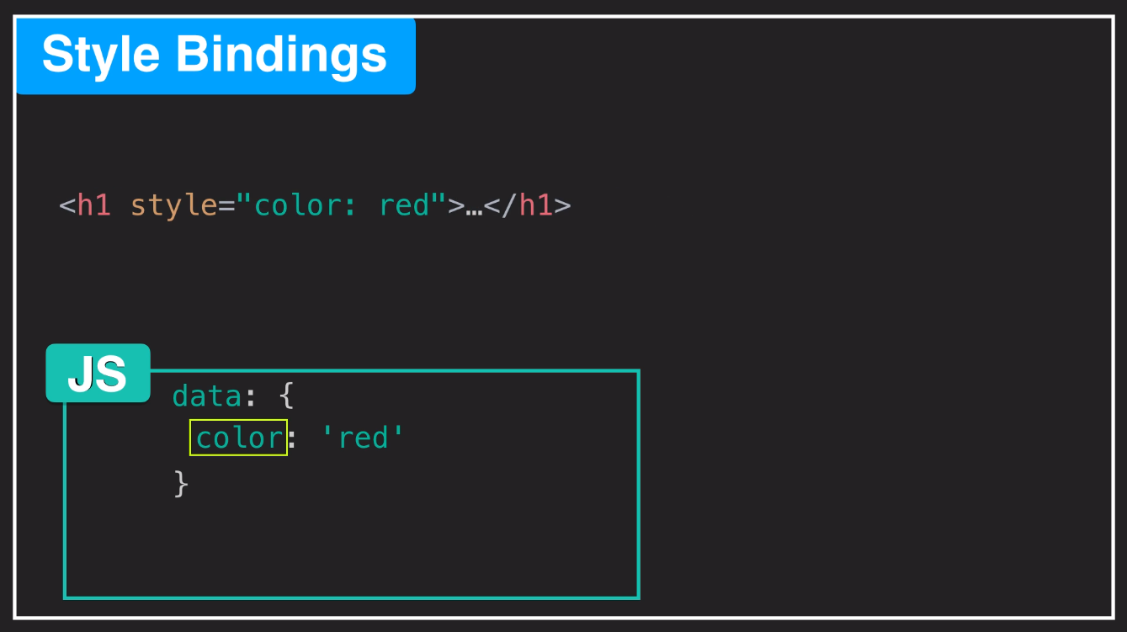

Slide 29
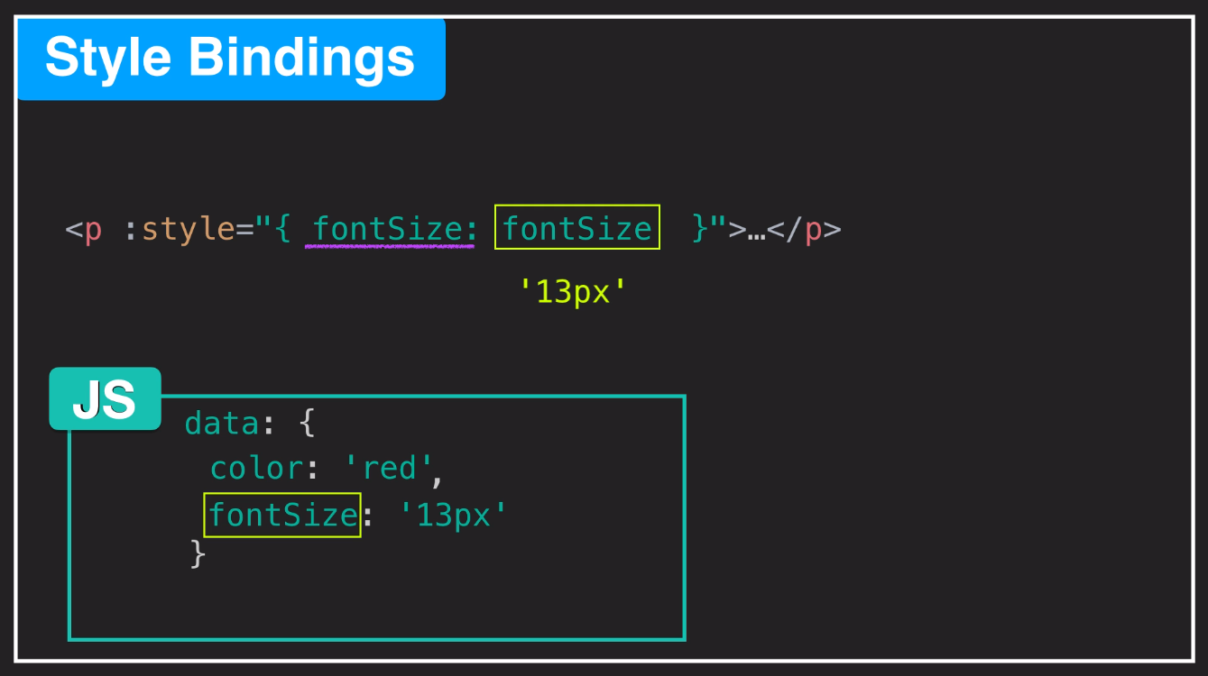

Slide 30
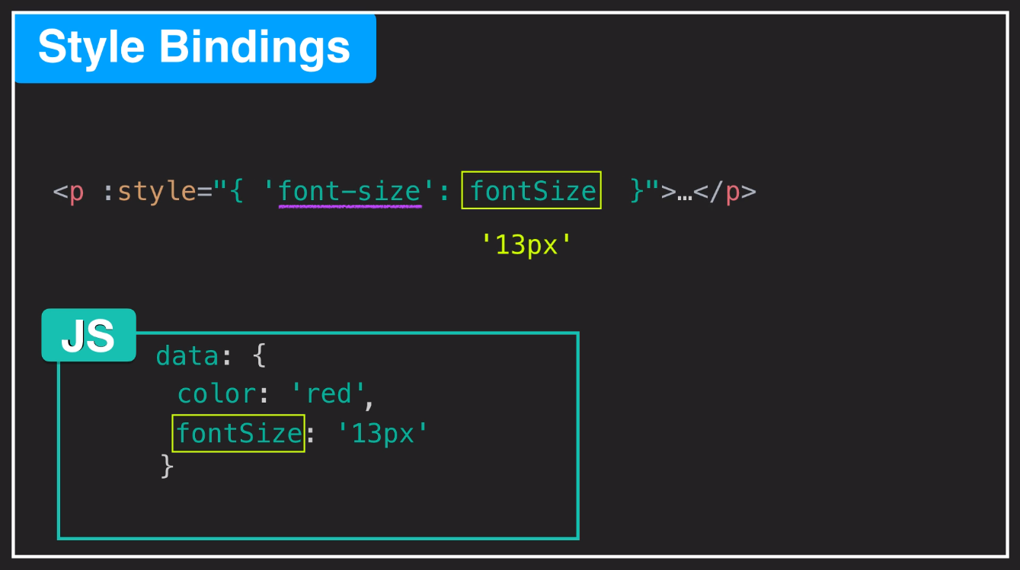

Slide 31
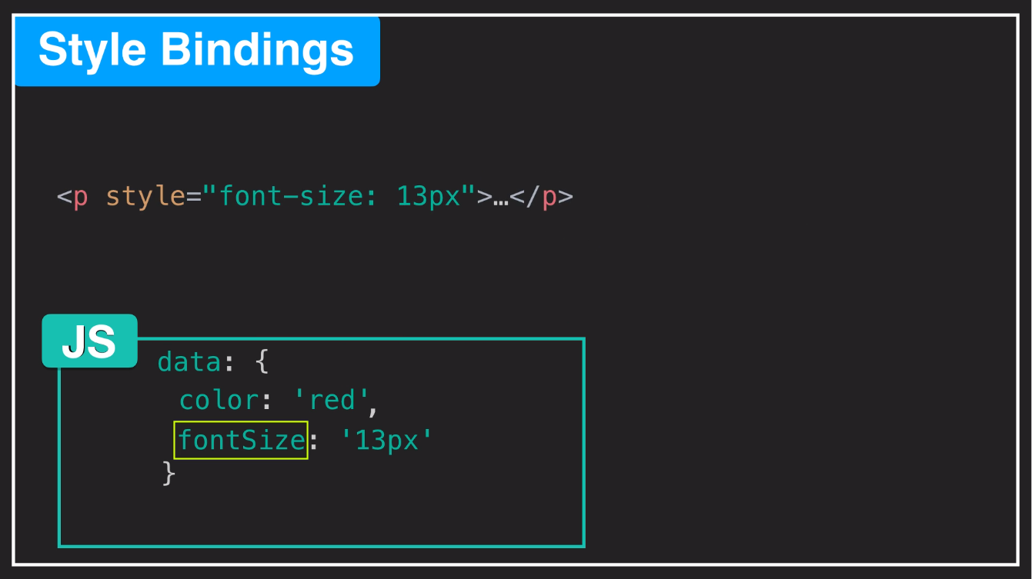

Slide 32
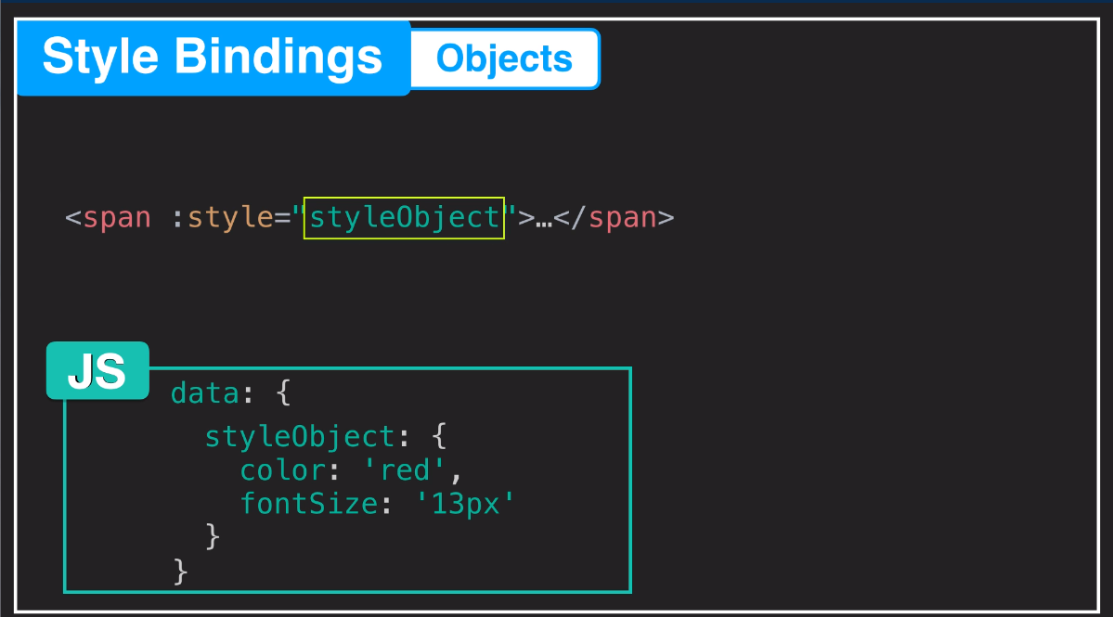

Slide 33
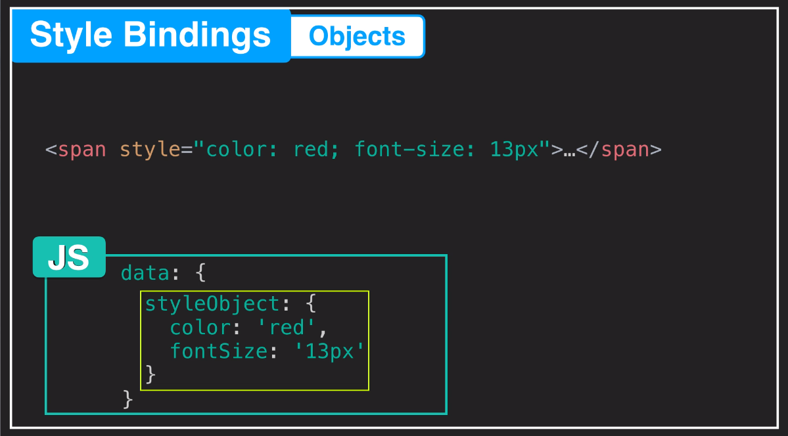

Slide 34
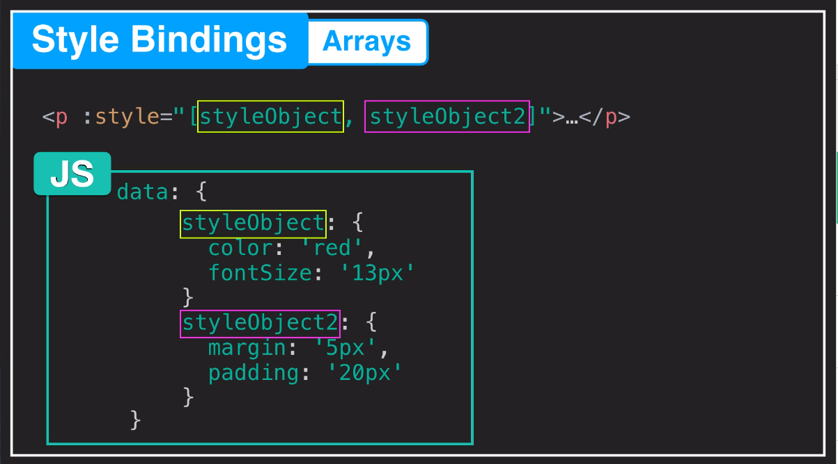

Slide 35
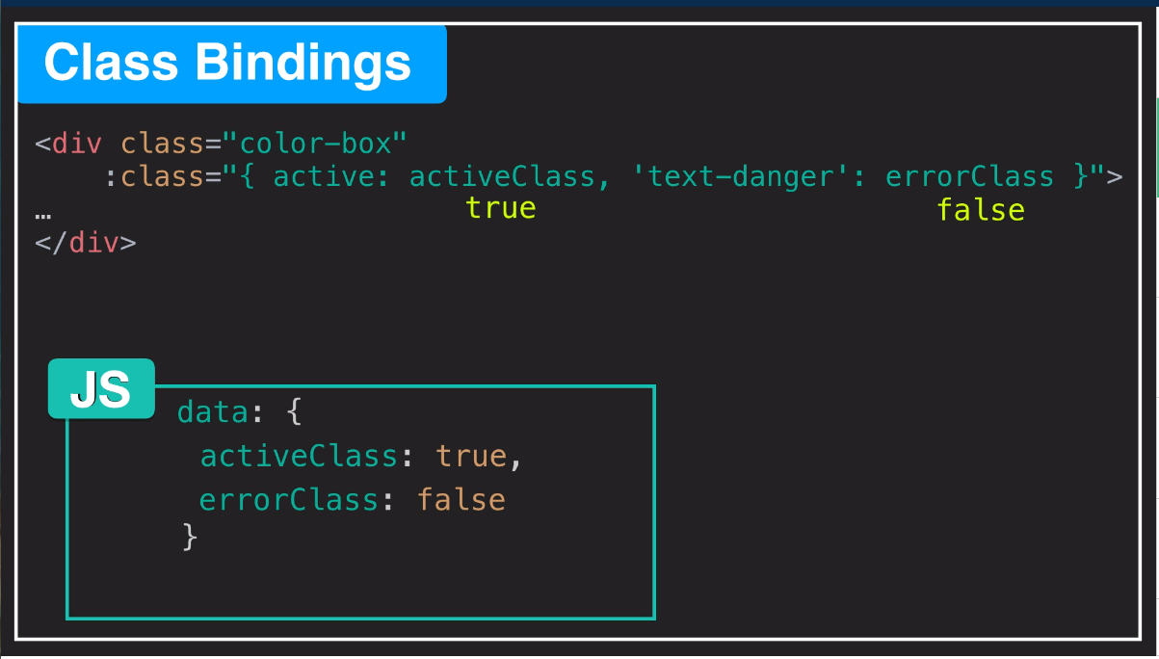

Slide 36
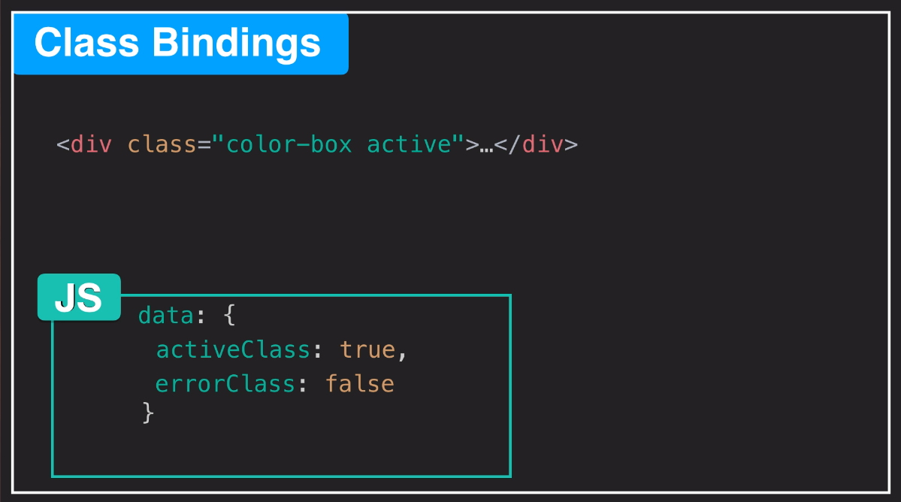

Slide 37
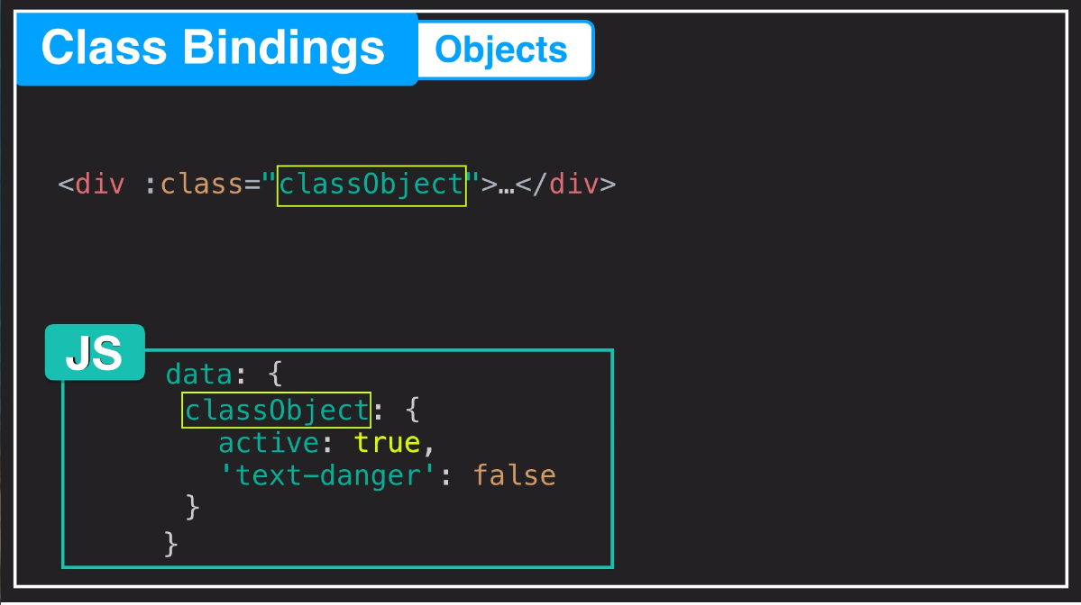

Slide 38


Slide 39
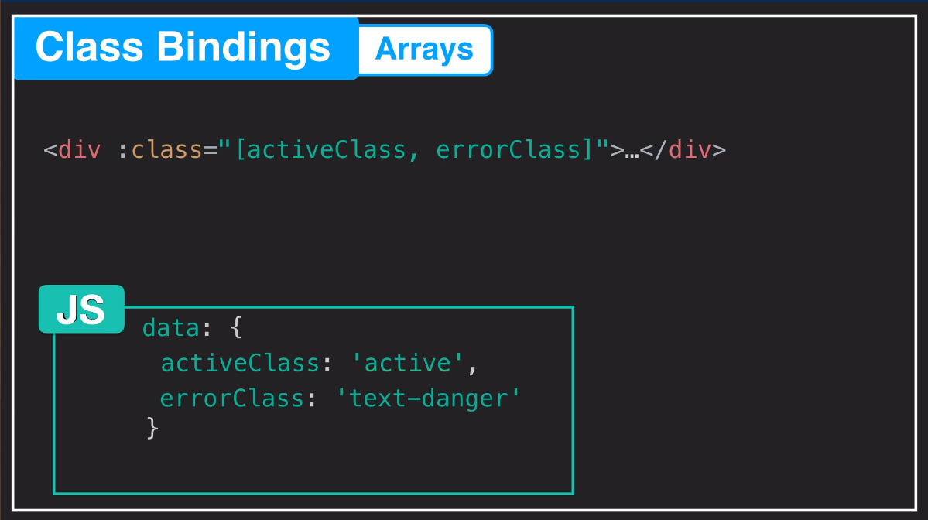

Slide 40
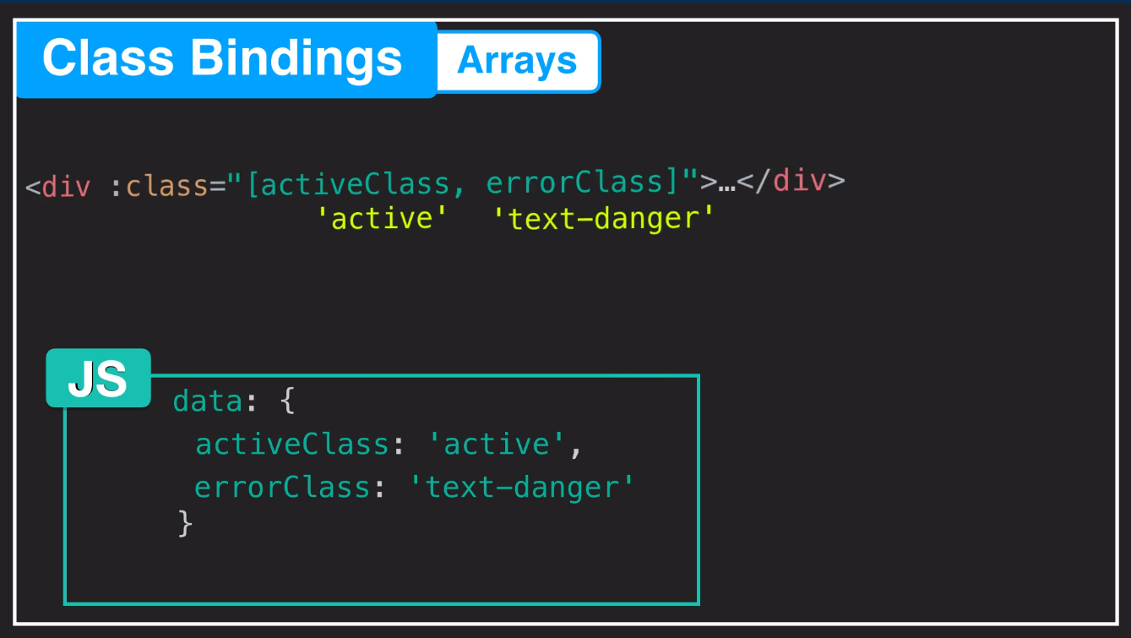

Slide 41
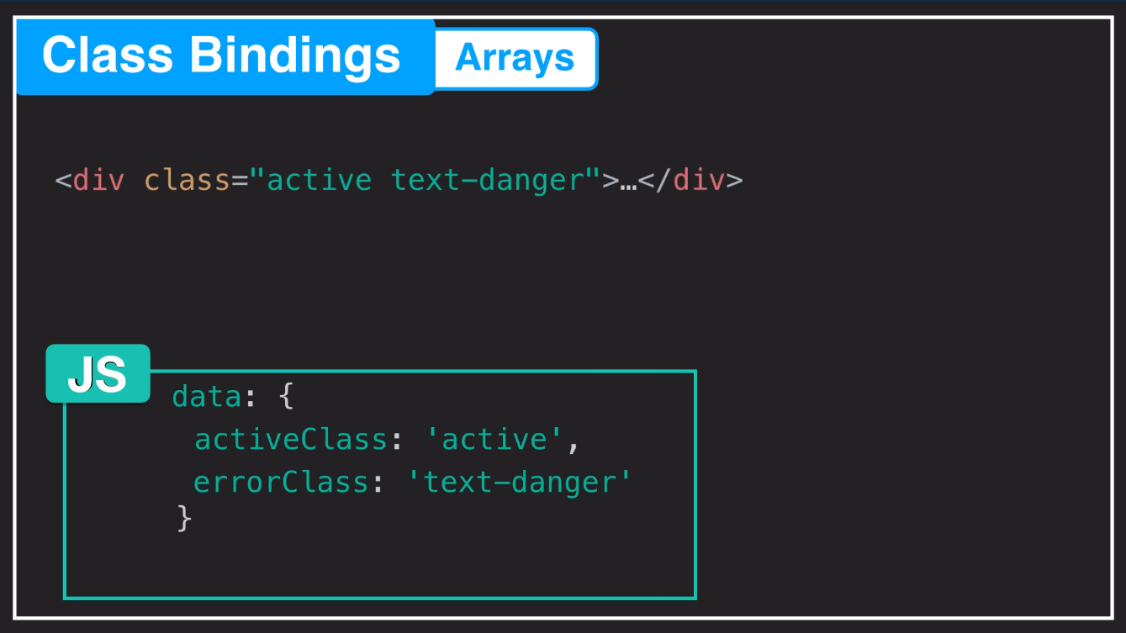

Slide 42
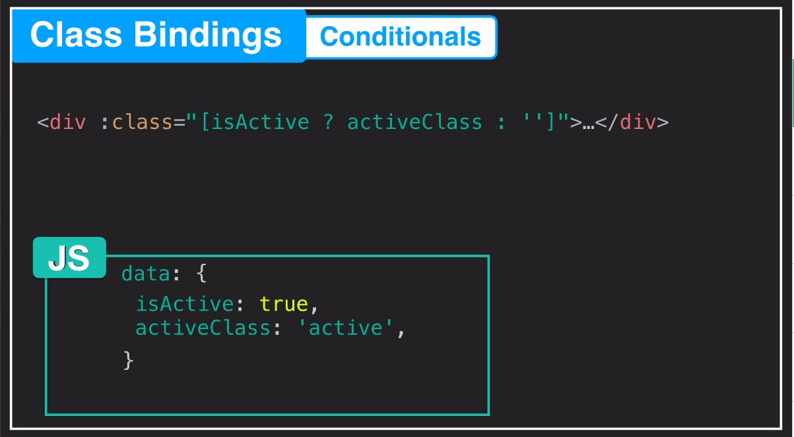

Slide 43
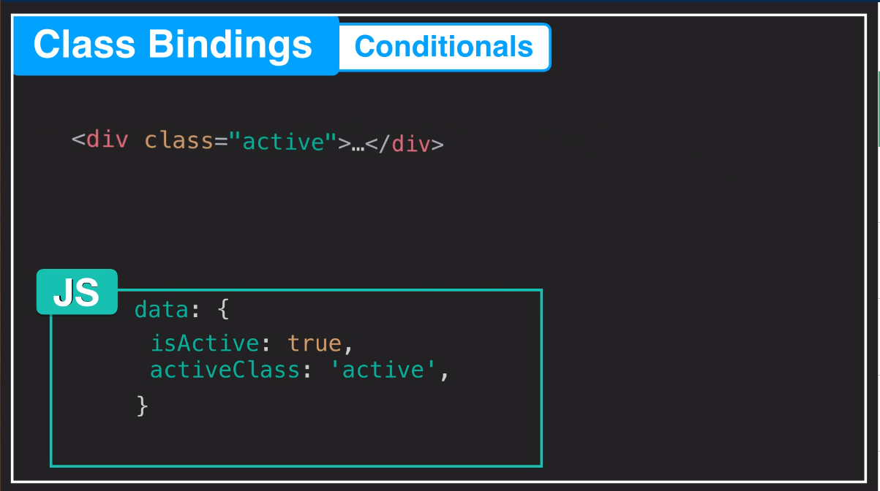

Slide 44
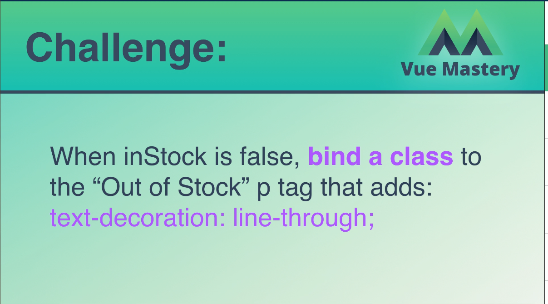

Slide 45
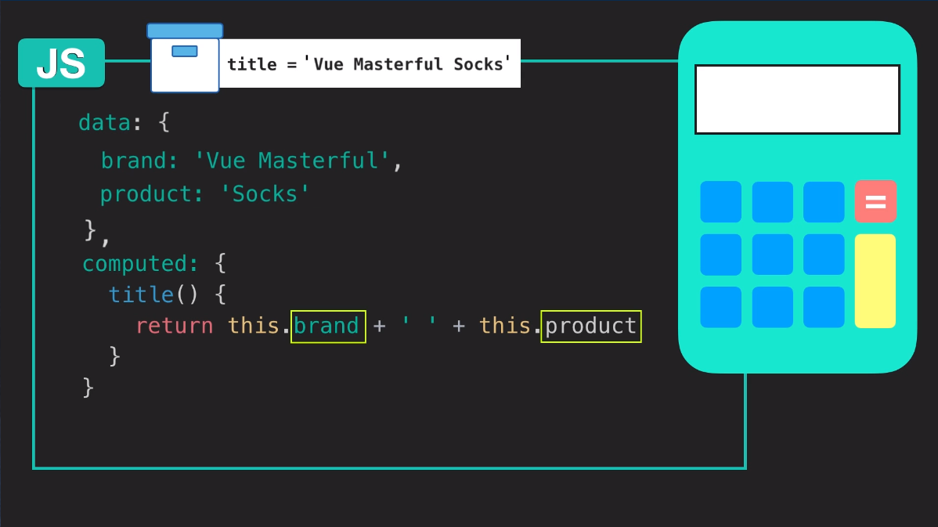

Slide 46
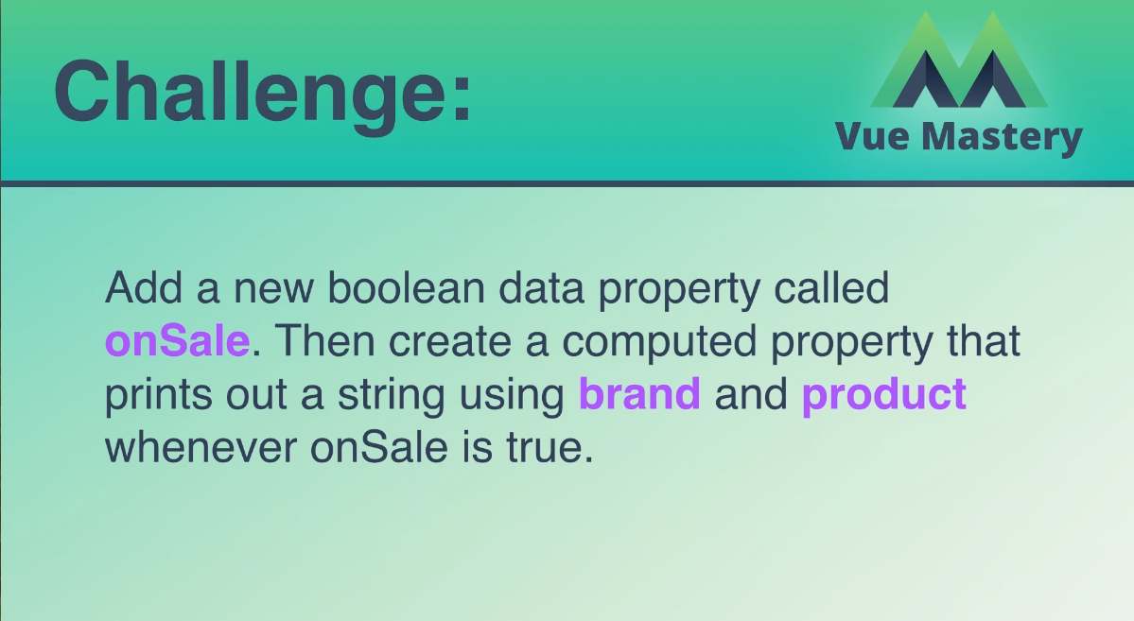

Slide 47
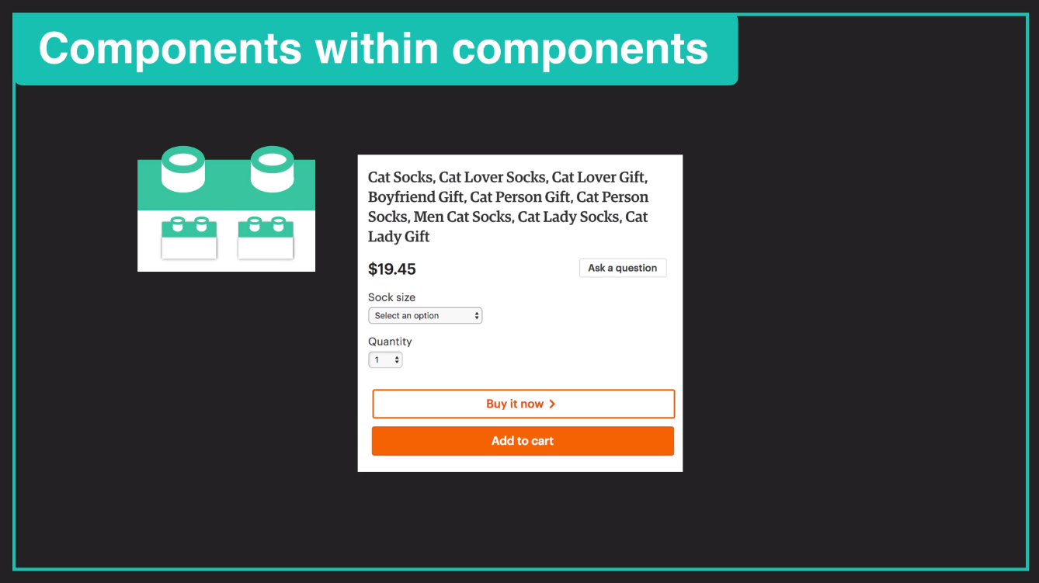

Slide 48
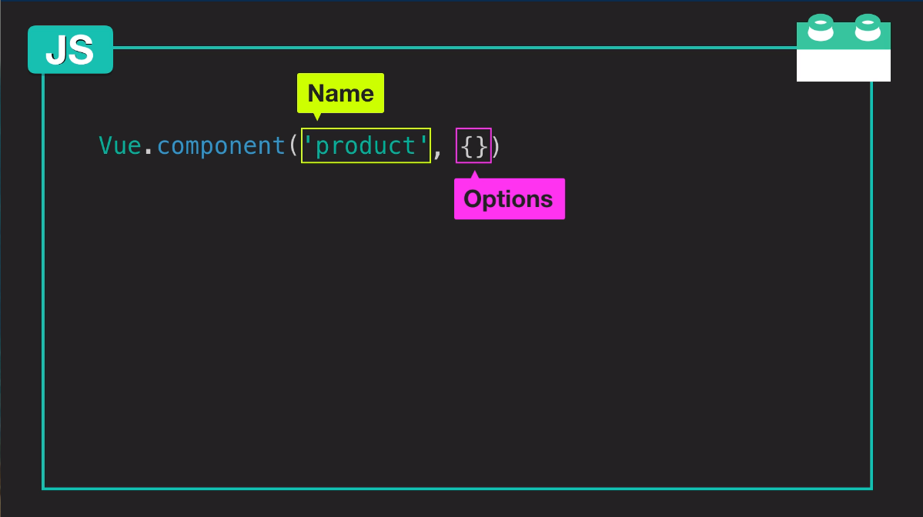

Slide 49
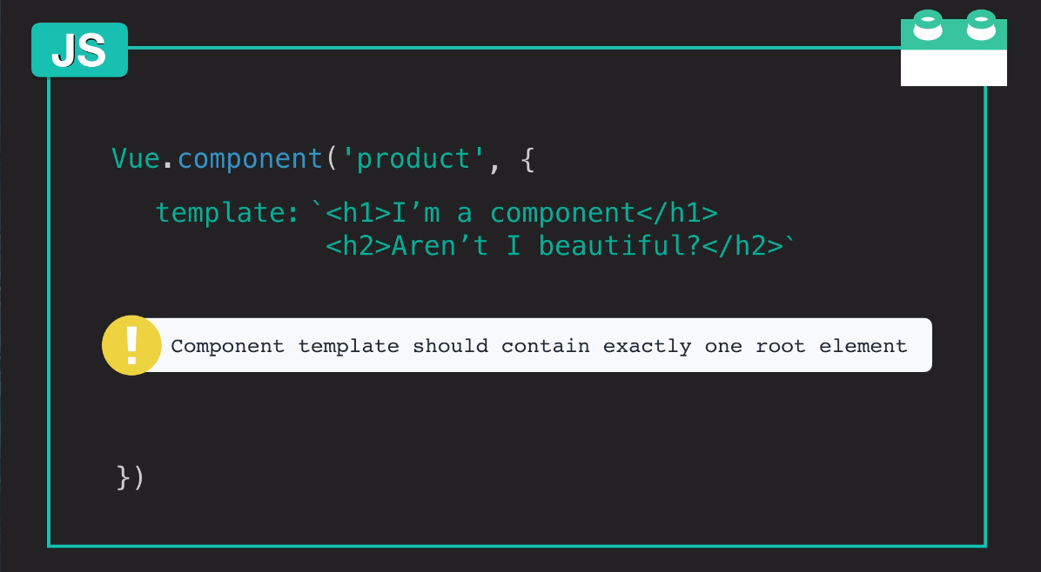

Slide 50
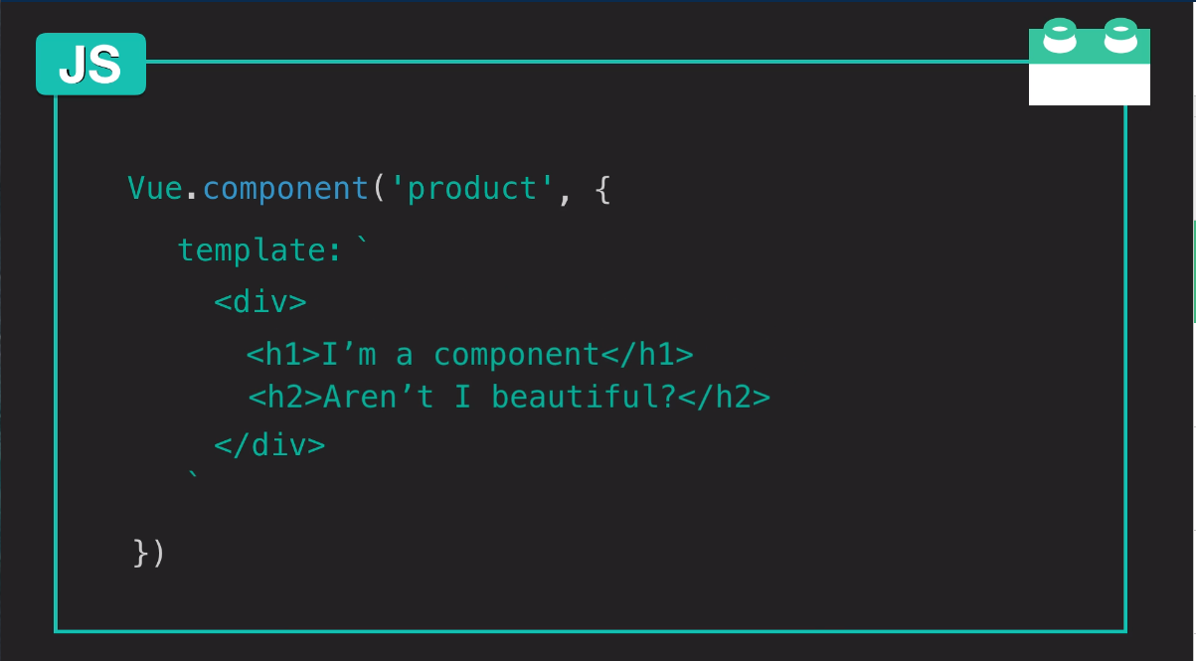

Slide 51
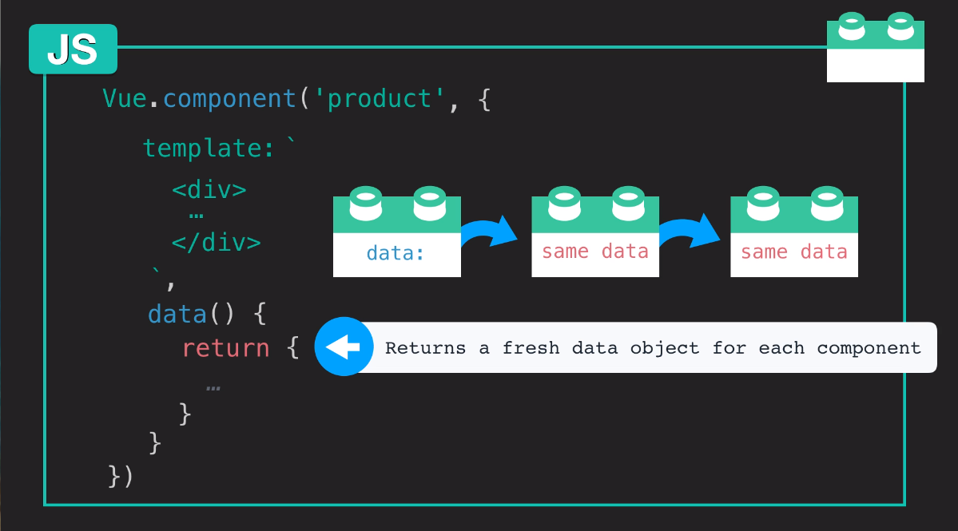

Slide 52
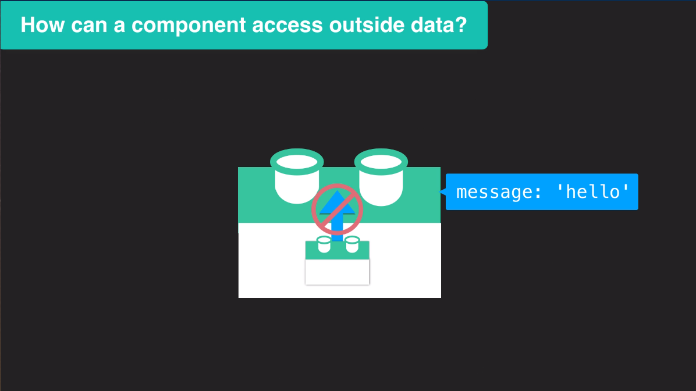

Slide 53
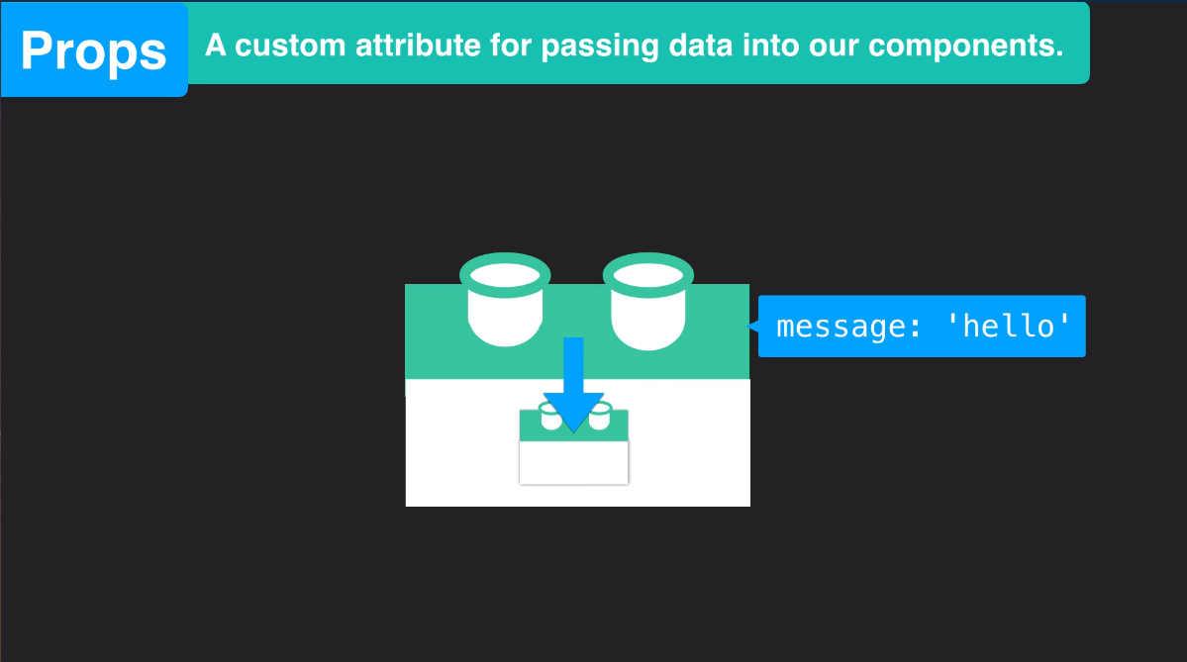

Slide 54
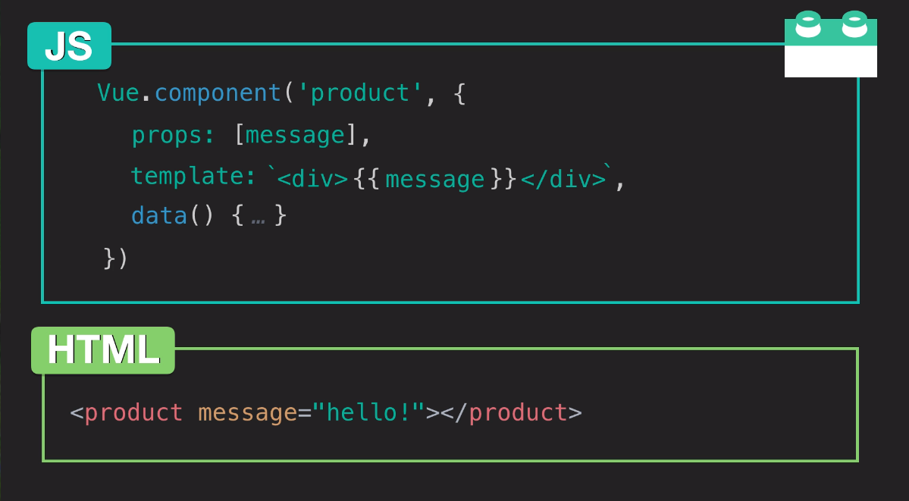

Slide 55
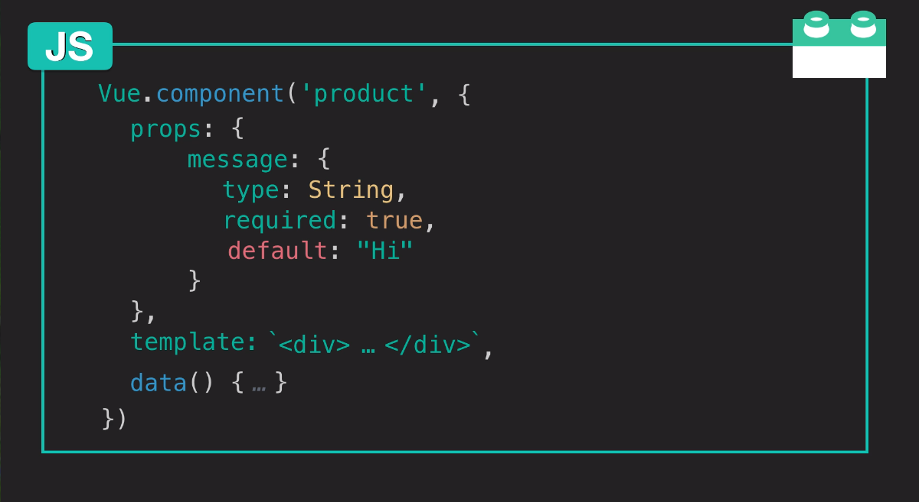

Slide 56
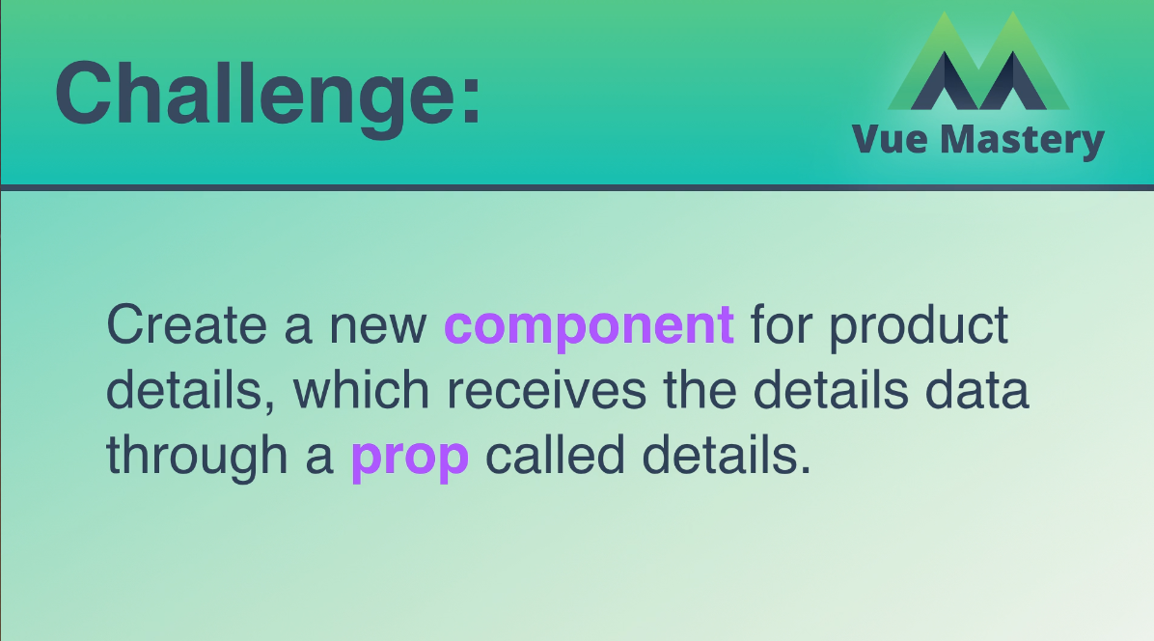

Slide 57
https://medium.com/js-dojo/7-ways-to-define-a-component-template-in-vuejs-c04e0c72900d
https://kr.vuejs.org/v2/guide/single-file-components.html

Slide 58
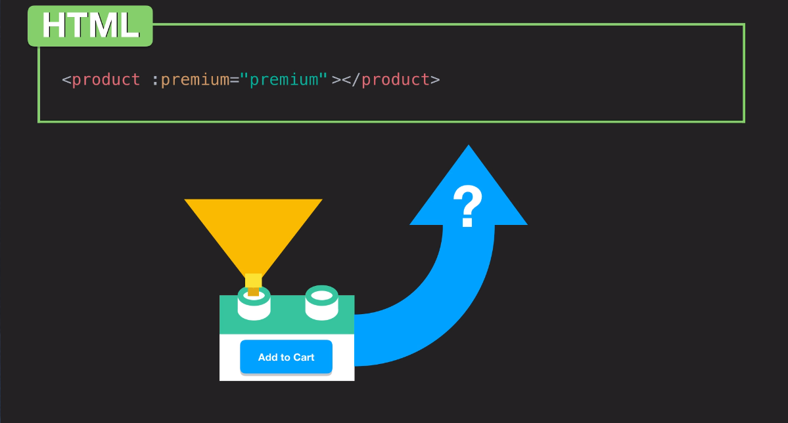

Slide 59
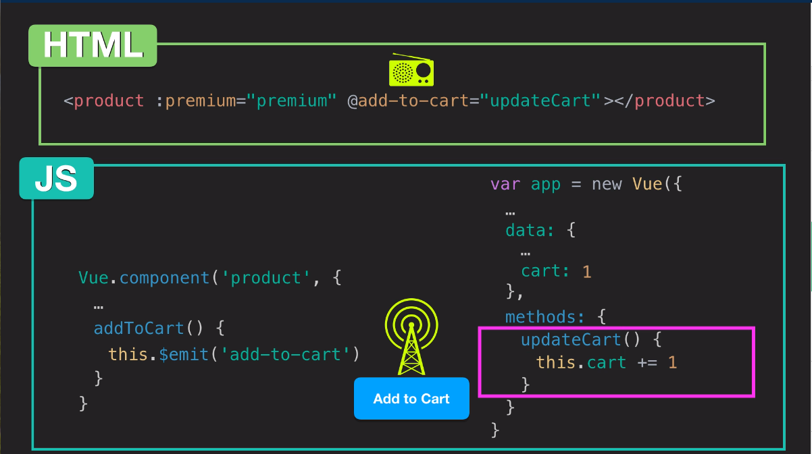

Slide 60
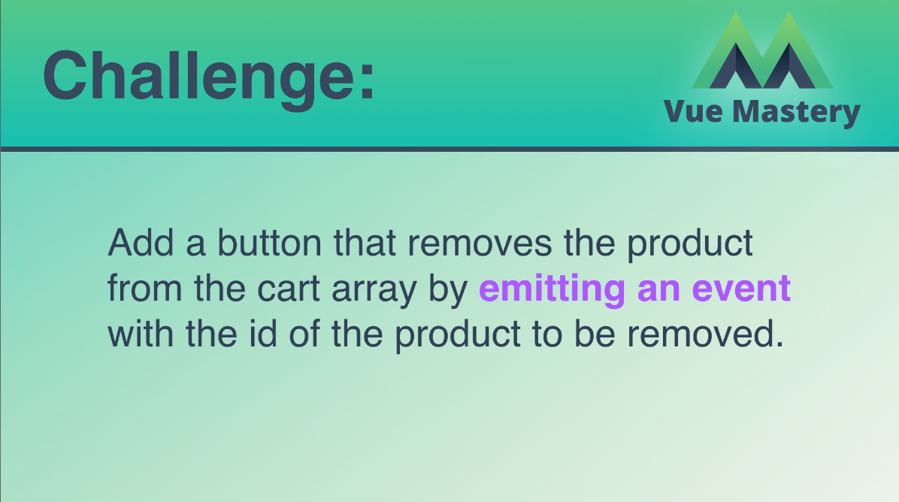

Slide 61


Slide 62


Slide 63
https://kr.vuejs.org/v2/guide/forms.html
https://kr.vuejs.org/v2/guide/events.html

Slide 64


